Slide 1

DIGITAL MARKETING AUTOMATOR FOR ENTERPRISE SEO AND SMO
PROJECT COORDINATOR
PROF NEETHU MOHAN
PROJECT GUIDE
PROF ANJANA J
Presented by
Sreelekshmi s s
S6 mca
LLMC18mca026

Slide 2
CONTENT
Abstract
Key features
Existing system
Drawbacks of existing system
Proposed system
Features of proposed system
Functions of proposed system
Modules
Data flow diagram
Screenshots
Conclusion
Future enhancement

Slide 3
ABSTRACT
Search engine optimization is the process of improving the quality and quantity of website traffic to a website or a web page from search engines. Social media optimization is the use of a number of outlets and communities to generate publicity to increase the awareness of a product, service brand or event. Digital Marketing Automator Build a robust SEO and marketing strategy with tools designed for every imaginable optimization task with a solution like SE Ranking. How are people searching for products/services? Knowing which keywords are being used and what questions are being asked can help to create high quality content. DMA Strategically target keywords with accurate keyword volume and difficulty metrics and Save keyword lists that you can track and update as needed, Know what searchers everywhere see by tracking local and national searches, crawler digs through every corner of site to find them and show client how to fix them.

Slide 4
Key features
Alerts ensure to know when site issues are found, so customer can fix them fast
Crawl and audit sites
Track website rankings
Create custom reports to improve site quality and performance
Control Budget for seo and smo
automatic marketing plan generator
keywords suggestion

Slide 5
Existing system
User has to make an analysis seo features and to update one by one or have to reach a seo service providing company.
Tools provide SEO insights to companies through a variety of different features, helping identify the best strategies to improve a website’s search relevance.
Many tools also offer competitor data and broad industry analysis.
SEO software is often used by product and marketing teams, as well as SEO specialists.

Slide 6
Drawbacks of existing system
Is time consuming.
User didn’t get entire reports and suggestions frequently.
Can’t get any dashboard access to view updates.
Can’t view investment details or fund needed for a period of time.
User end in doubts and misunderstandings.

Slide 7
Proposed system
The proposed system is an online marketing Automator. The online system enables companies to streamline, automate, and measure marketing tasks and workflows so they can increase operational efficiency and grow revenue faster. This system is designed to allow organizations to more effectively market on multiple channels and automate repetitive tasks.

Slide 8
Proposed system (seo)
Search Engine Optimization (SEO) is important for websites to improve the rank for search results and get more page views requested by the user. This search engine ranks provide the better and optimized result to user, which will help them to view the popular page among the number of pages available in the search results. Apart from this search engine ranking, it also enables the websites to compete with other rival's website as each and every website owner expect to see their own website on the list before other's websites.

Slide 9
Proposed system(smo)
Social Media Optimisation (SMO) has become an integral part of online marketing. It engages the business owner in proper communication via social media that helps to connect with the maximum audience directly under the same platform. It helps to reach the potential customer and adds up a valuable advantage element to your business. Therefore, digital marketing efforts can definitely take your brand to the next level.

Slide 10
Features of proposed system (SEO)
Automated SEO analysis
Automated SEO Checker
Site Speed
Backlink Checker

Slide 11
Features of proposed system(smo)
The system use relevant and genuine SMO services to help all kinds of businesses creating their brand visibility on social media platforms.
The system generates better leads by adding videos, events, articles, feeds, reviews, audio and music sharing blogs and other relevant content to grab the attention of the maximum users.
The system enhances the quality of interaction and increase the sales of an organization. proper tagging, addition, well-linked content and other tools are optimized to make a user-friendly platform for the visitors.
The system provides updates and keep your online platform maintained timely. We redefine, reflect and convert your visitors into customers.
SMO packages-the system provides different deals and offers.

Slide 12
Functions of proposed system
Instantly analyse your SEO issues.
Professional SEO monitoring tool
Understand your competitor’s SEO profile
SEO reports you can understand and act upon.
Instantly analyse your SMO
Automating SMO advertisement creation.
Regular reports and updates will be sent for monitoring.

Slide 13
Modules
SEO optimizer
Keyword optimization
Competitor analysis
Search engine-based analysis
Statitics and Analytics
Backlinks
SMO
Social media optimization deals with analysing and managing social media platforms. Different social media applications accounts can be linked to the system for optimization and automate the process of SMO by posting data in social media.

Slide 14
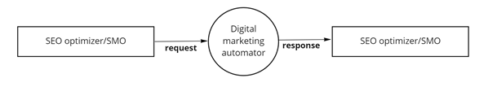
Data flow diagram
Context level/ level 0

Slide 15
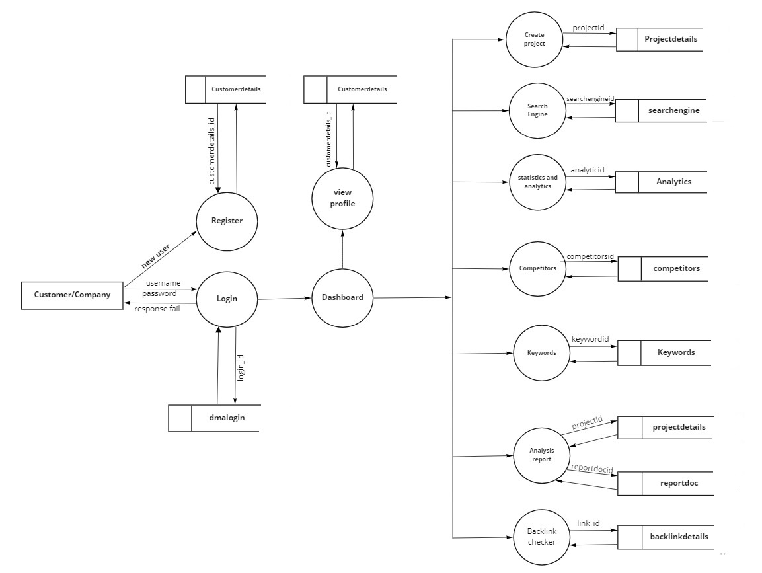
Level 1 of seo optimizer

Slide 16
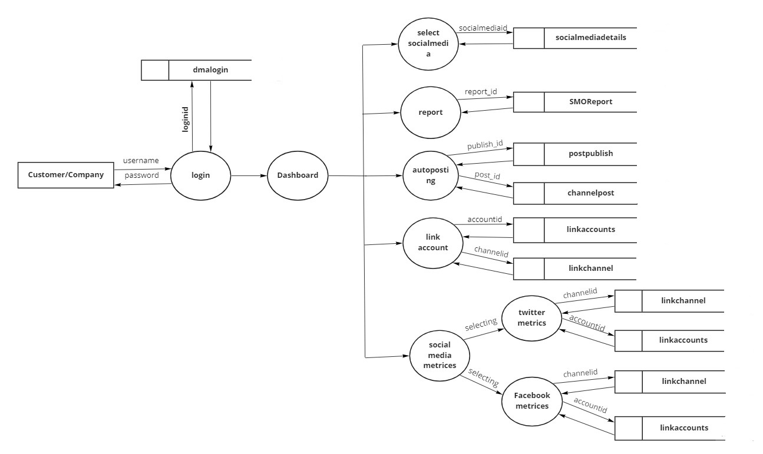
Level 1 of smo

Slide 17
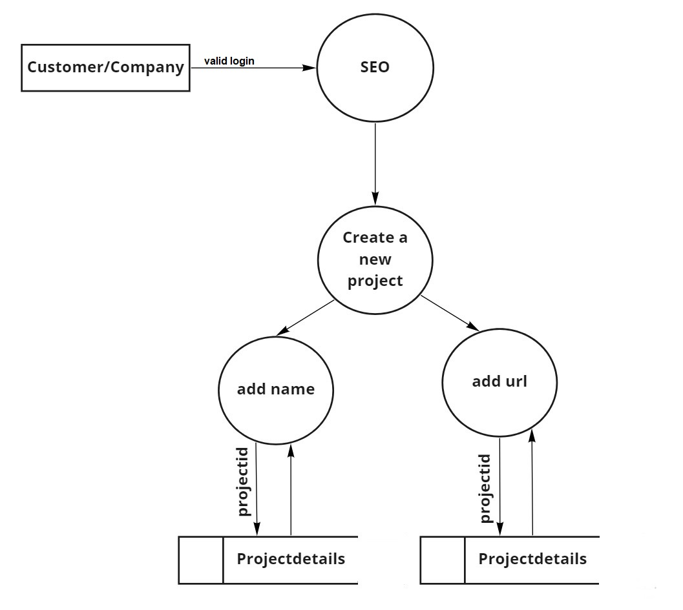
Level 1.1 of seo

Slide 18
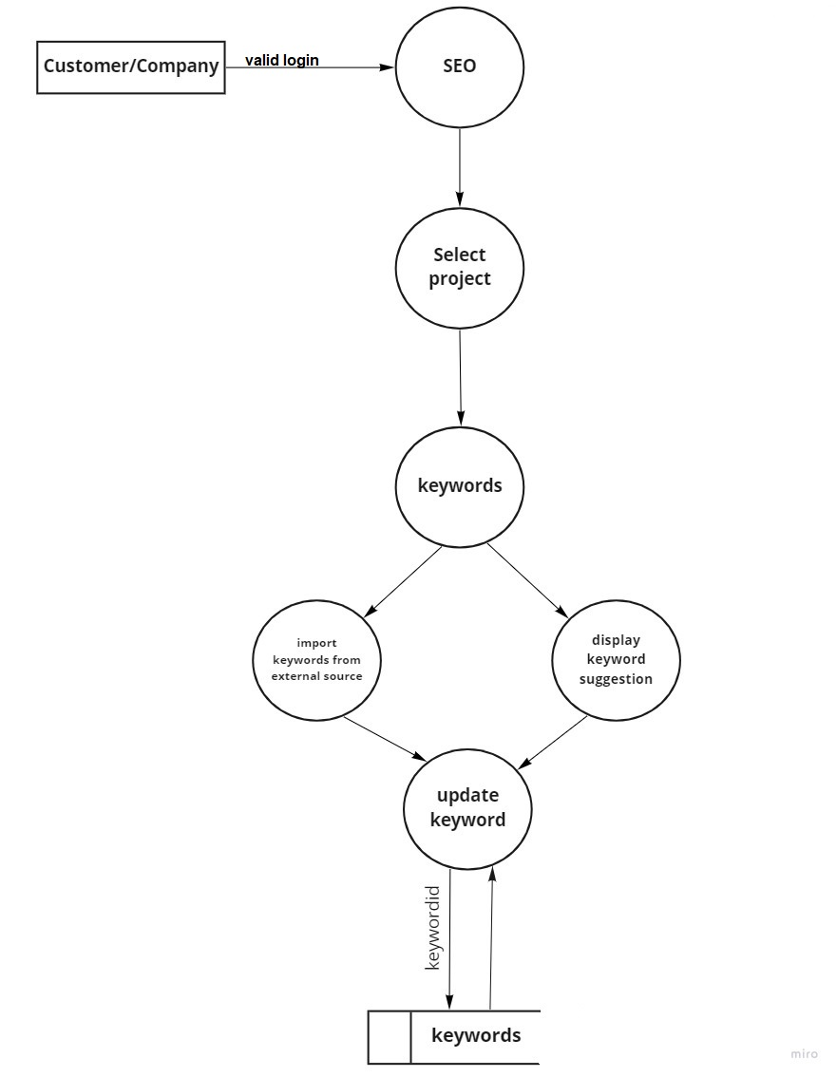
Level 1.2 of seo

Slide 19
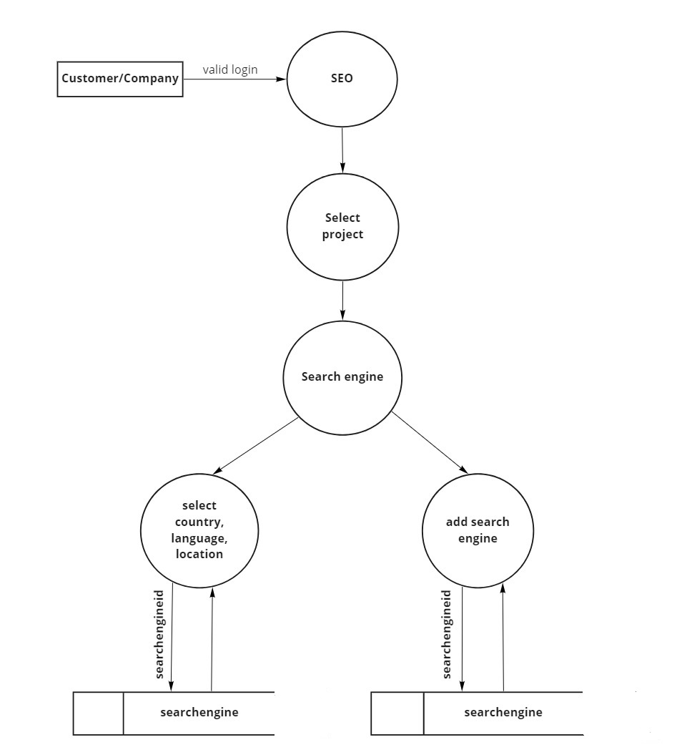
Level 1.3 of seo

Slide 20
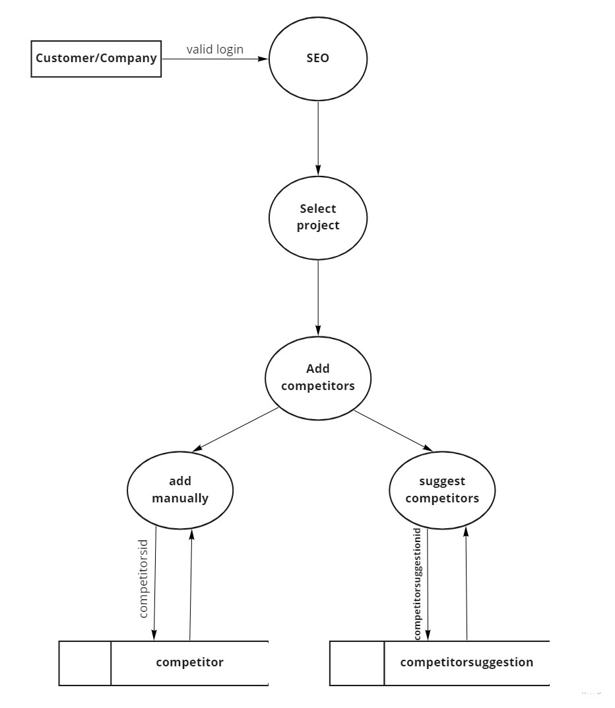
Level 1.4 of seo

Slide 21
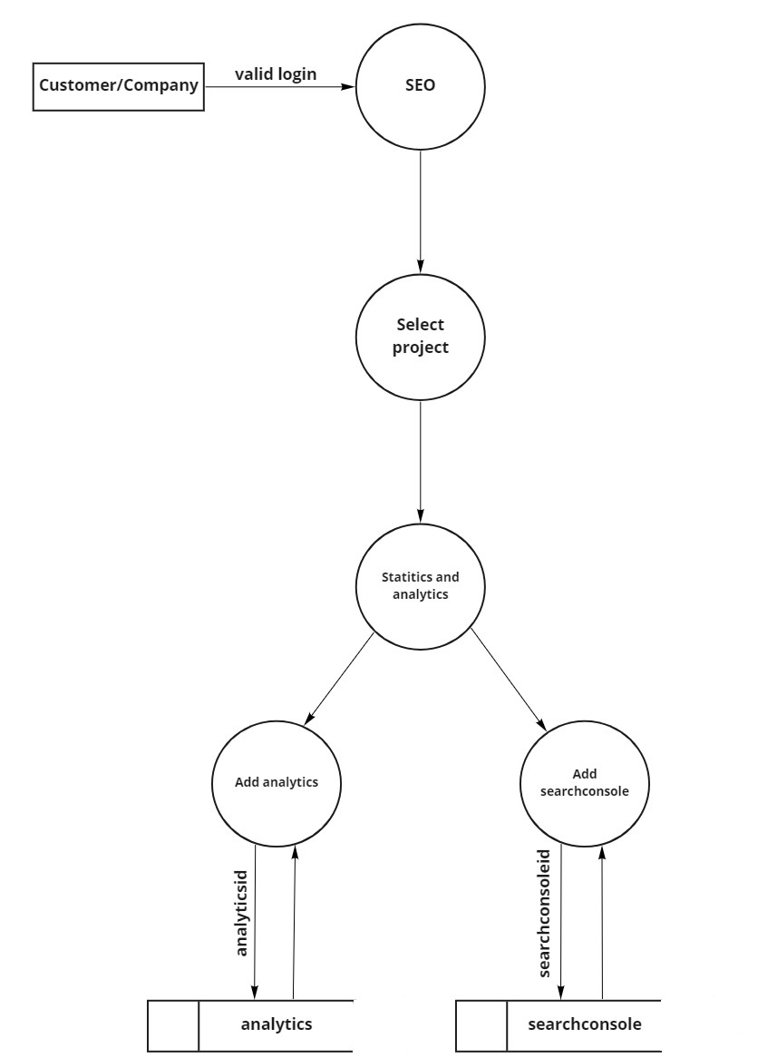
Level 1.5 of seo

Slide 22
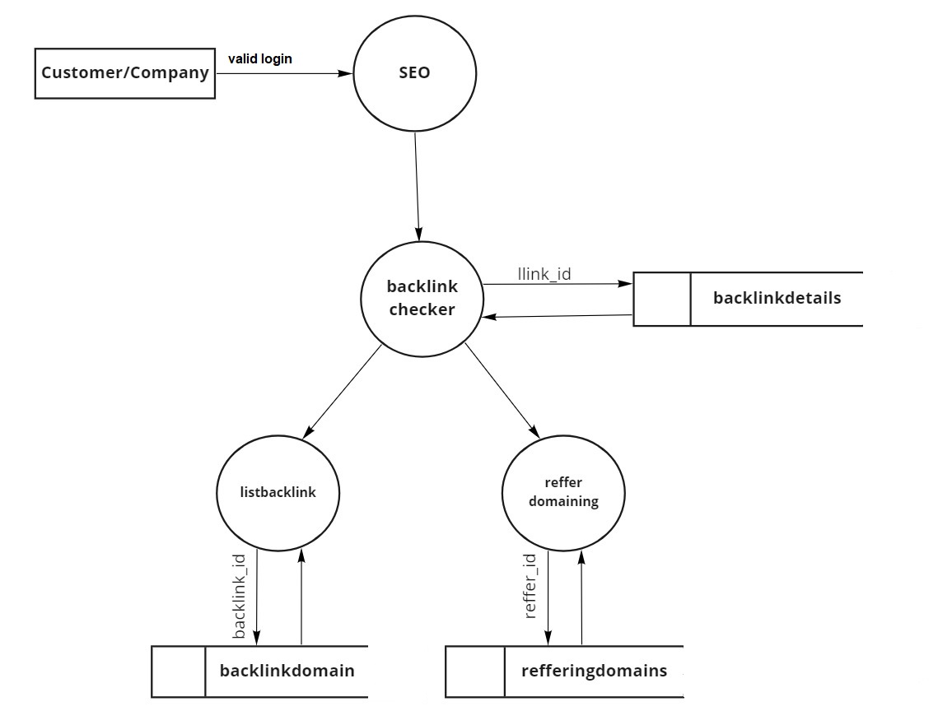
Level 1.6 of seo

Slide 23
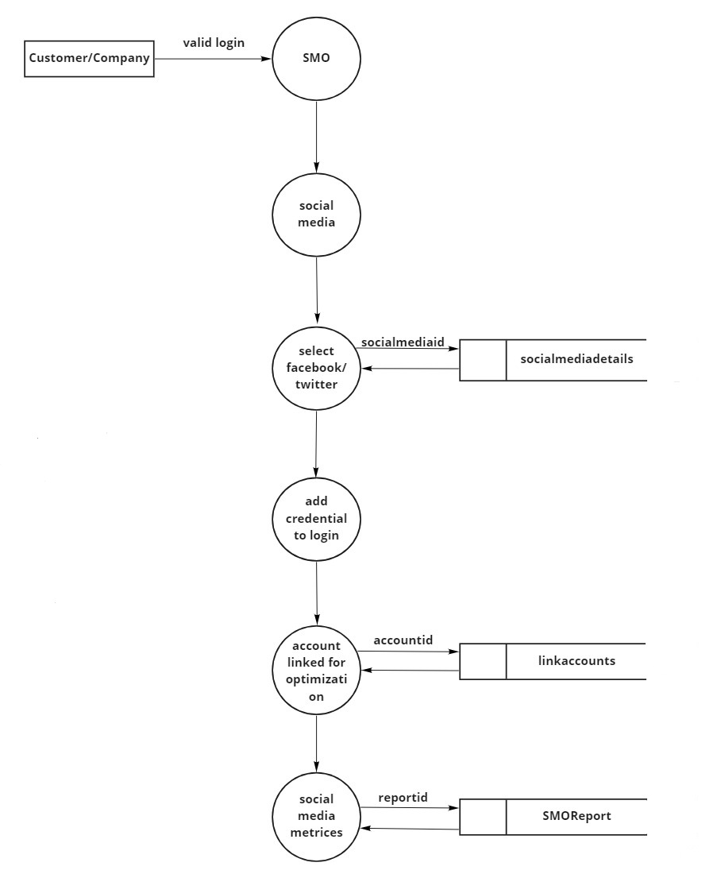
Level 1.1 of smo

Slide 24
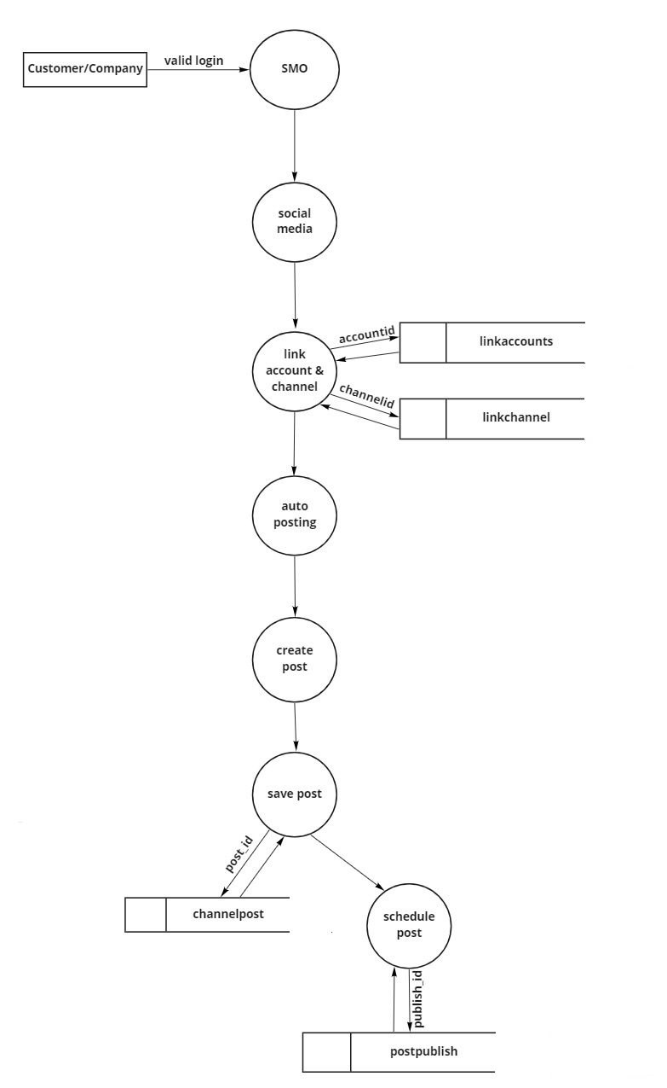
Level 1.2 of Smo

Slide 25
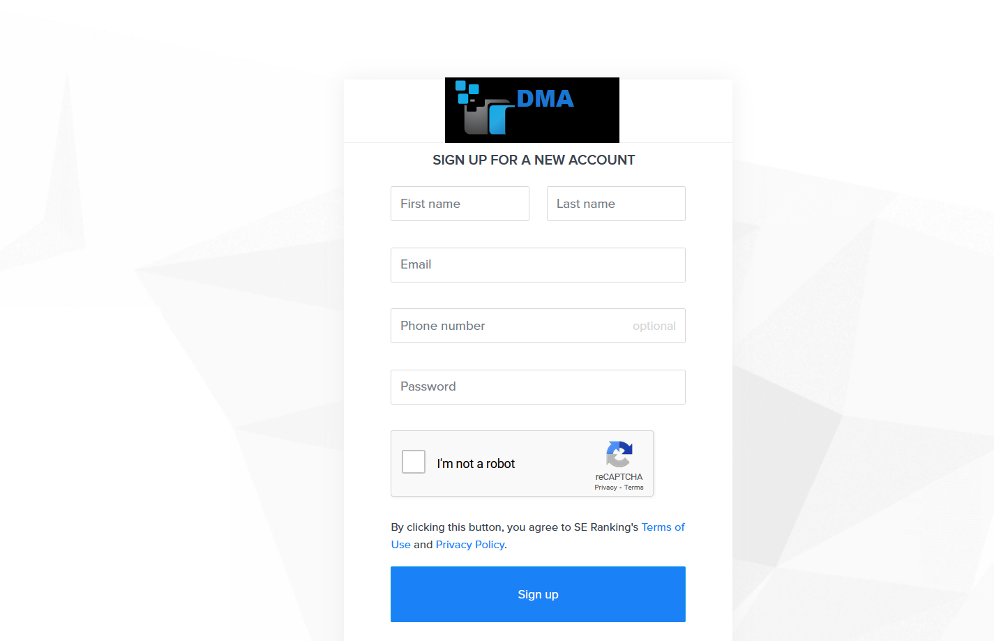
Screenshots
Customer registration

Slide 26
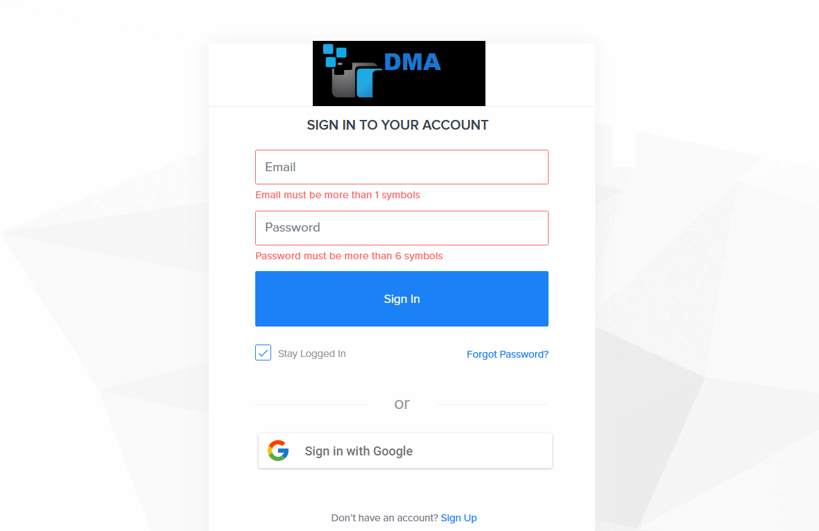
login page

Slide 27
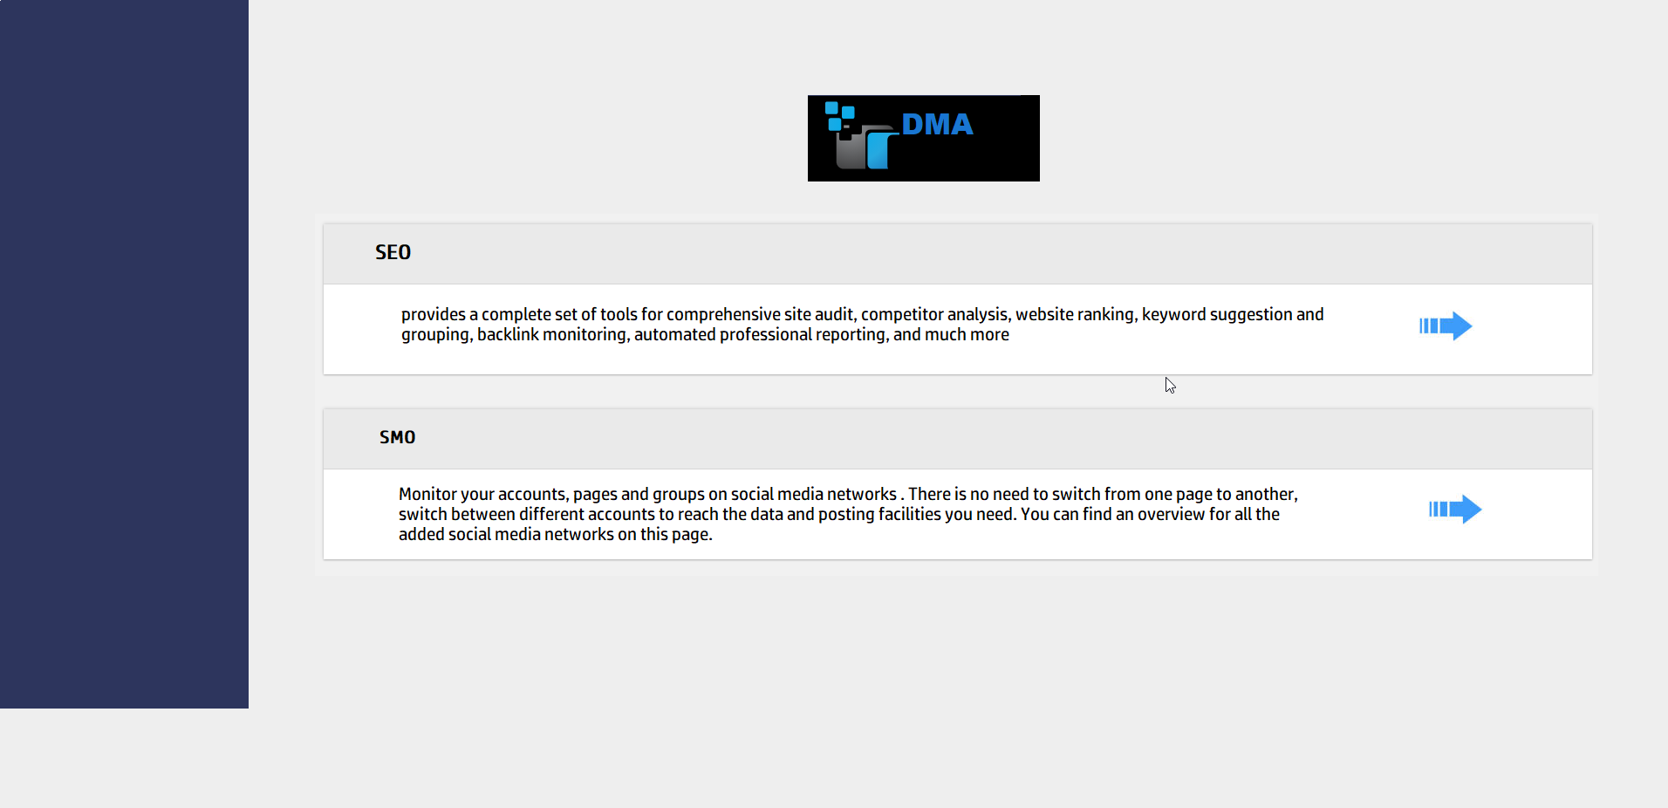

Slide 28
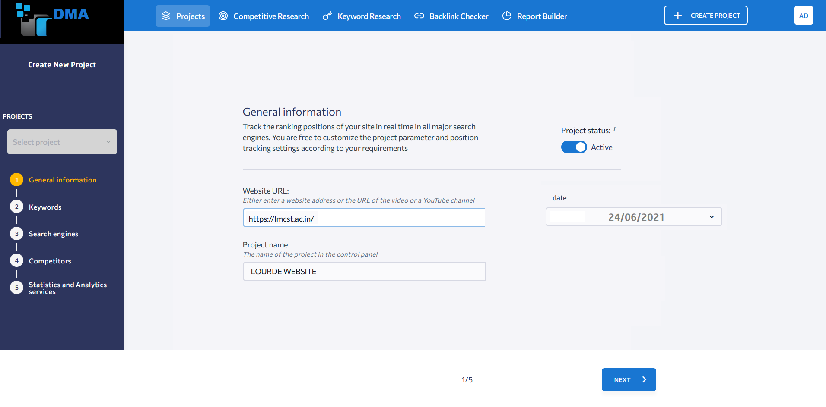
Creating the project

Slide 29
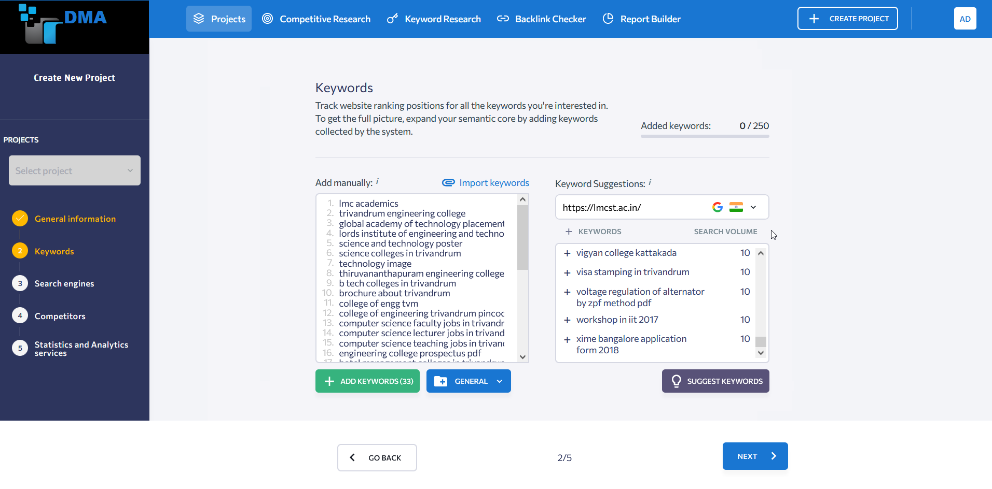
Keyword selecting

Slide 30
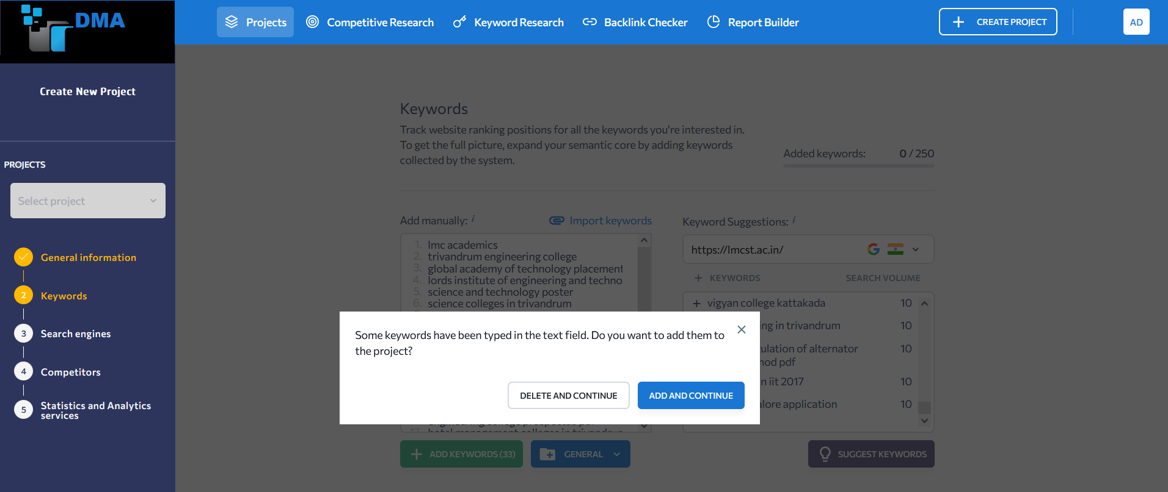
Confirmation(keyword)

Slide 31
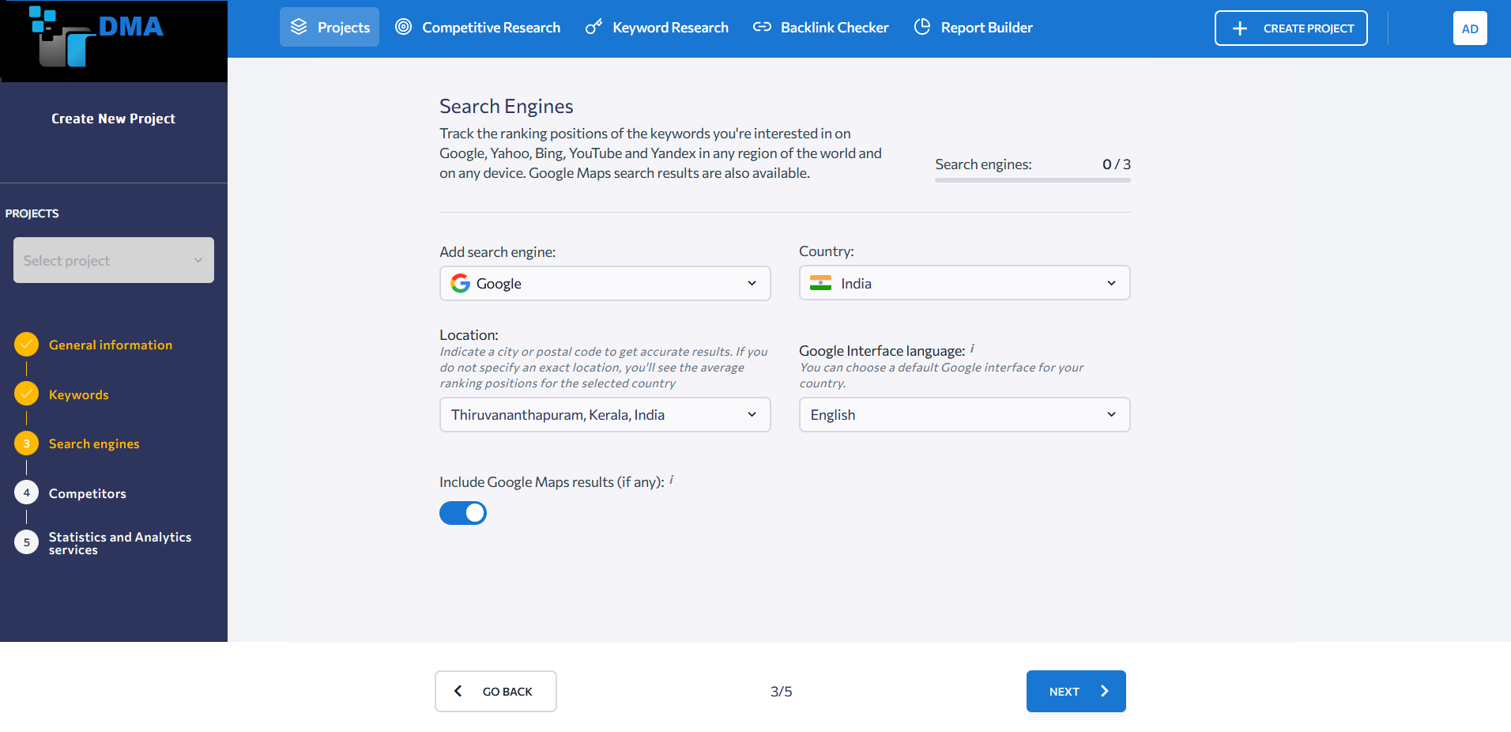

Slide 32
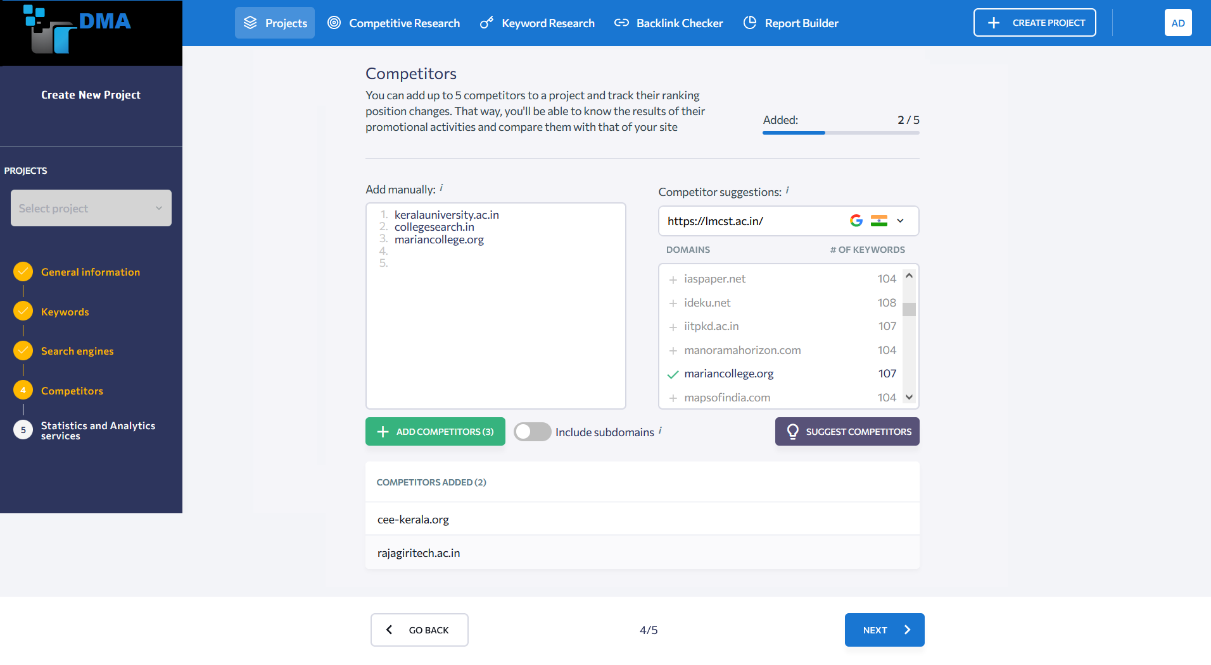

Slide 33
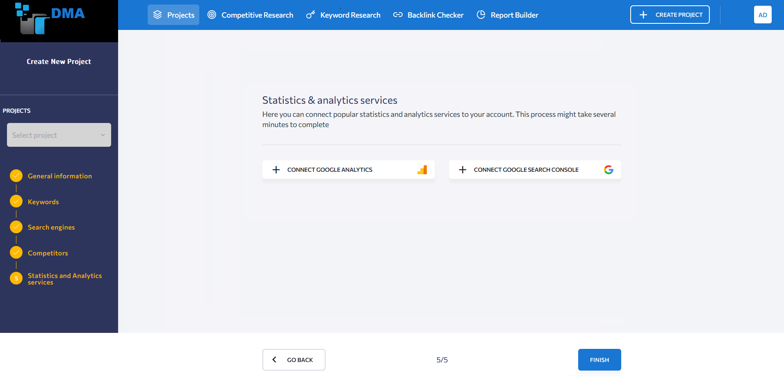

Slide 34
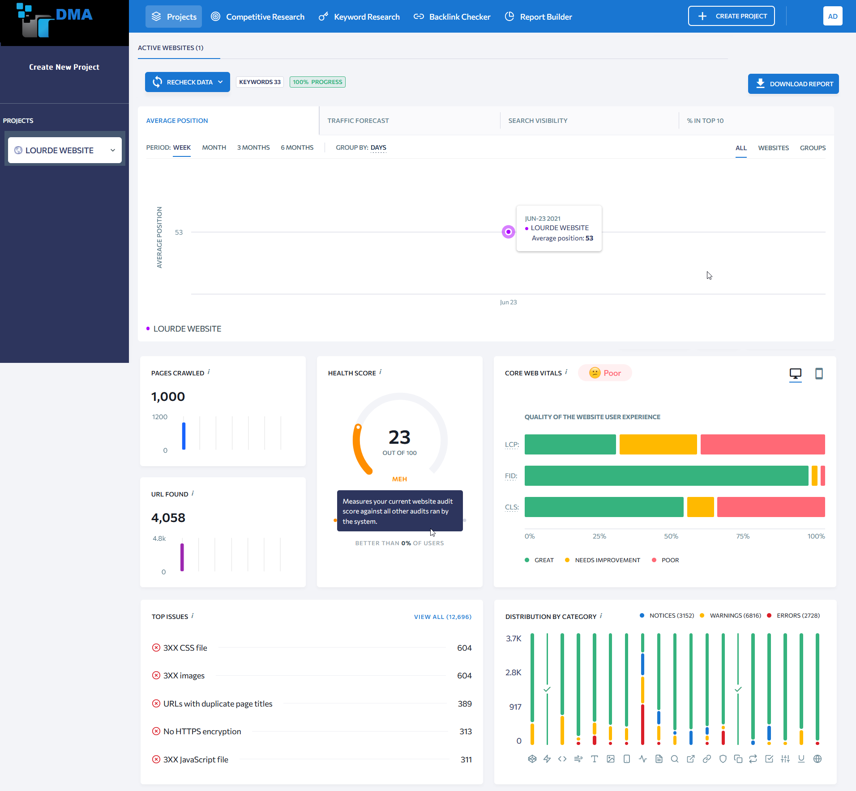

Slide 35
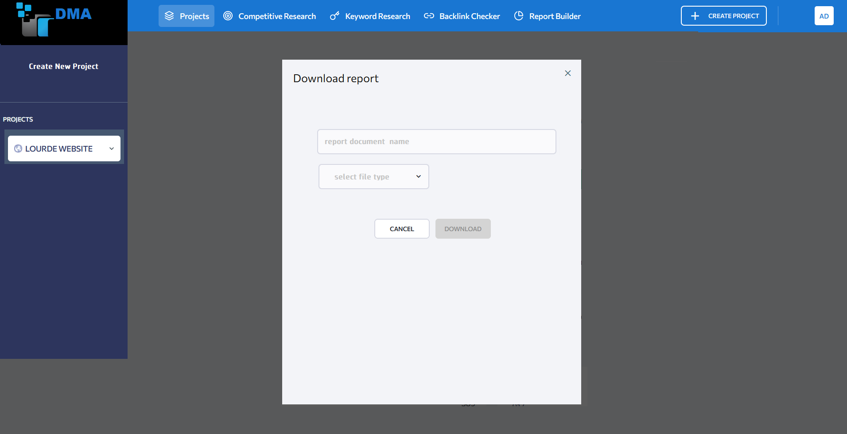

Slide 36
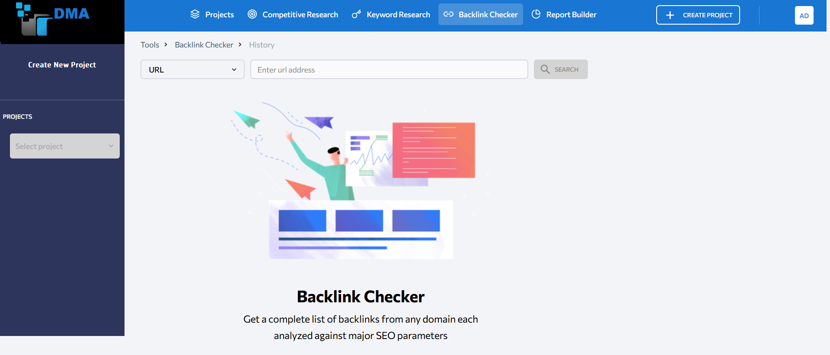

Slide 37
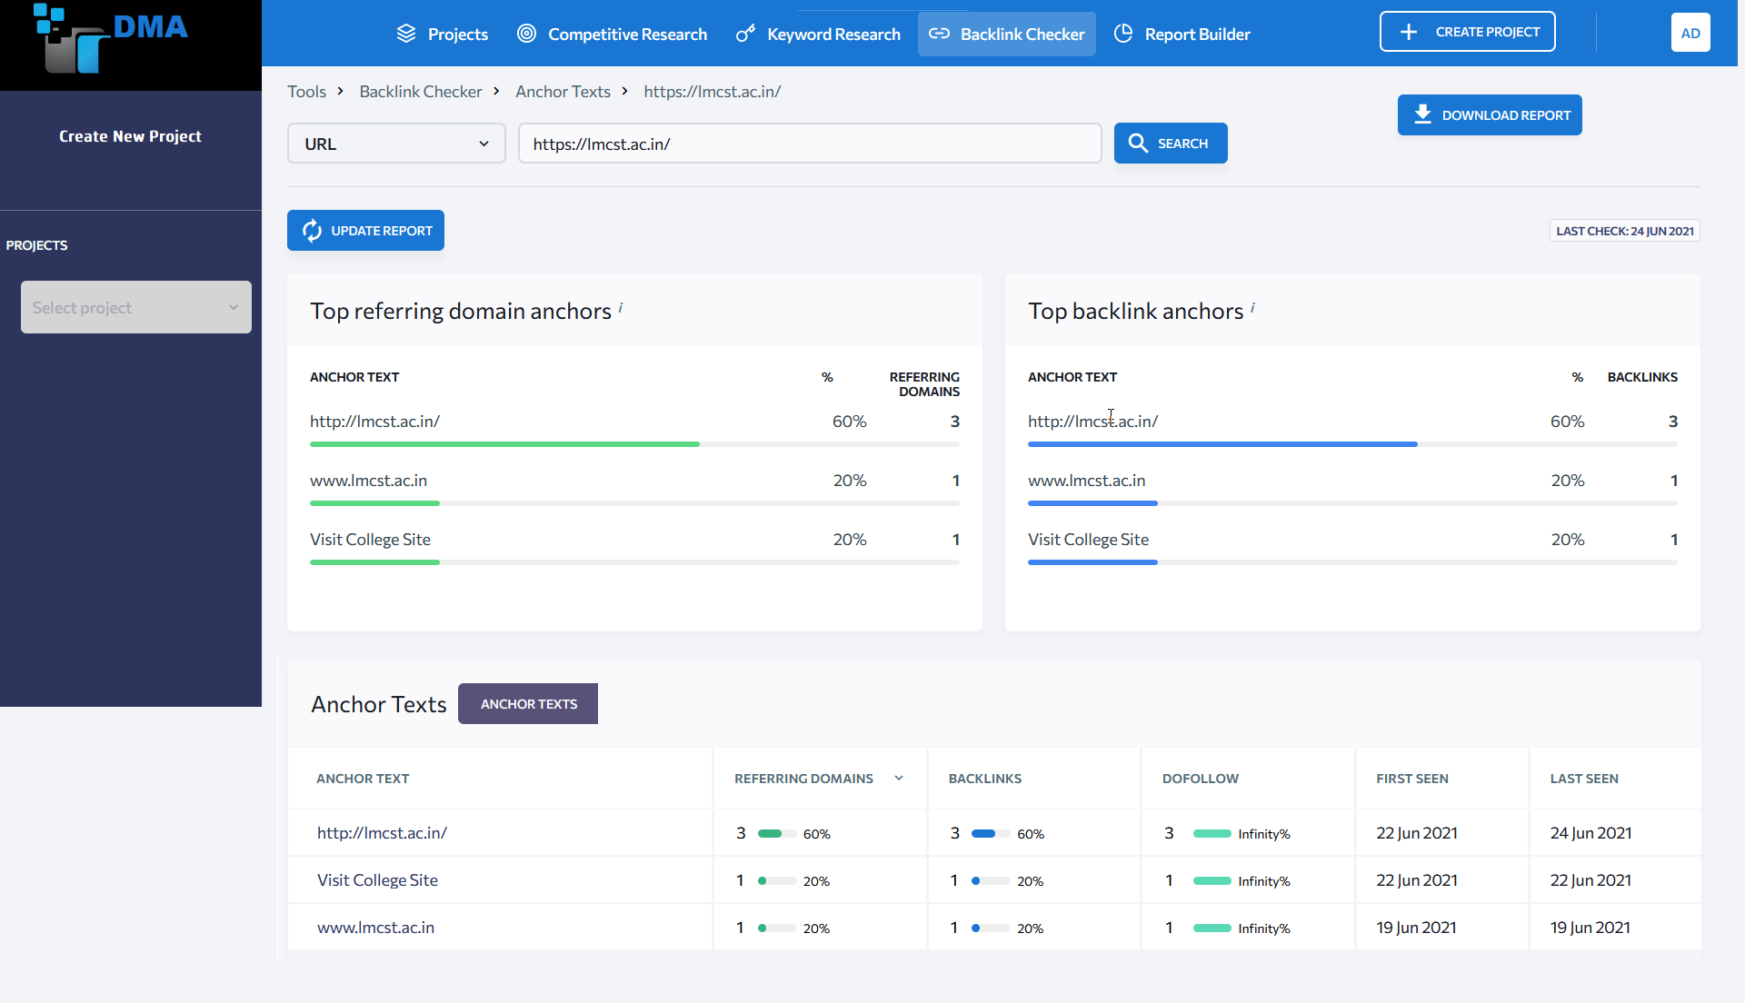

Slide 38
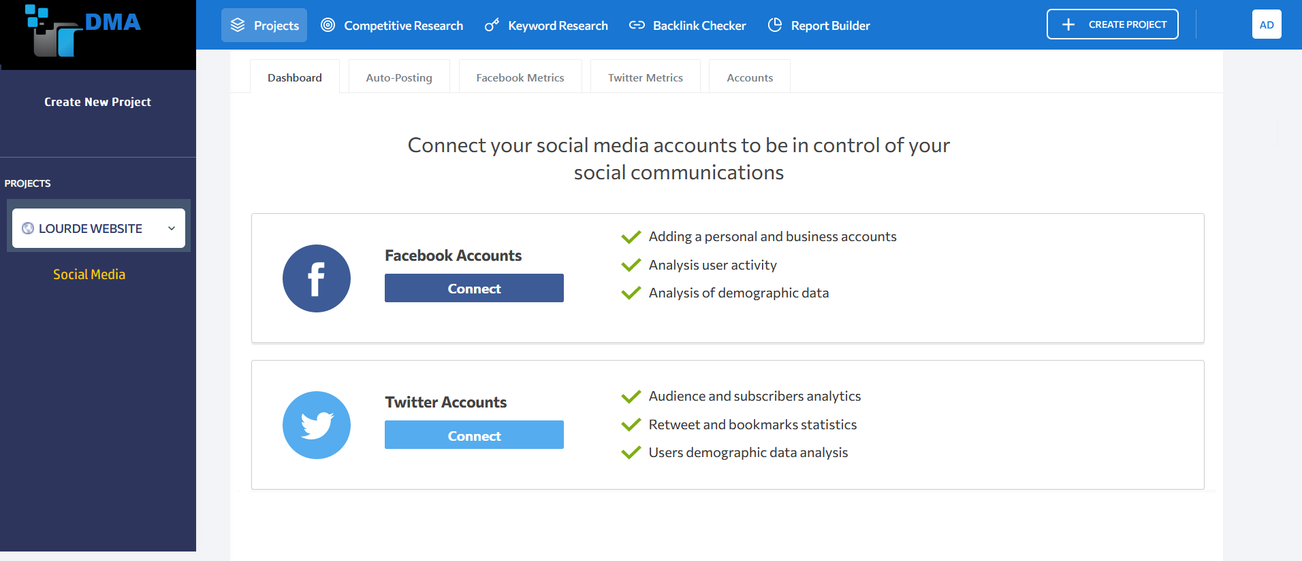

Slide 39
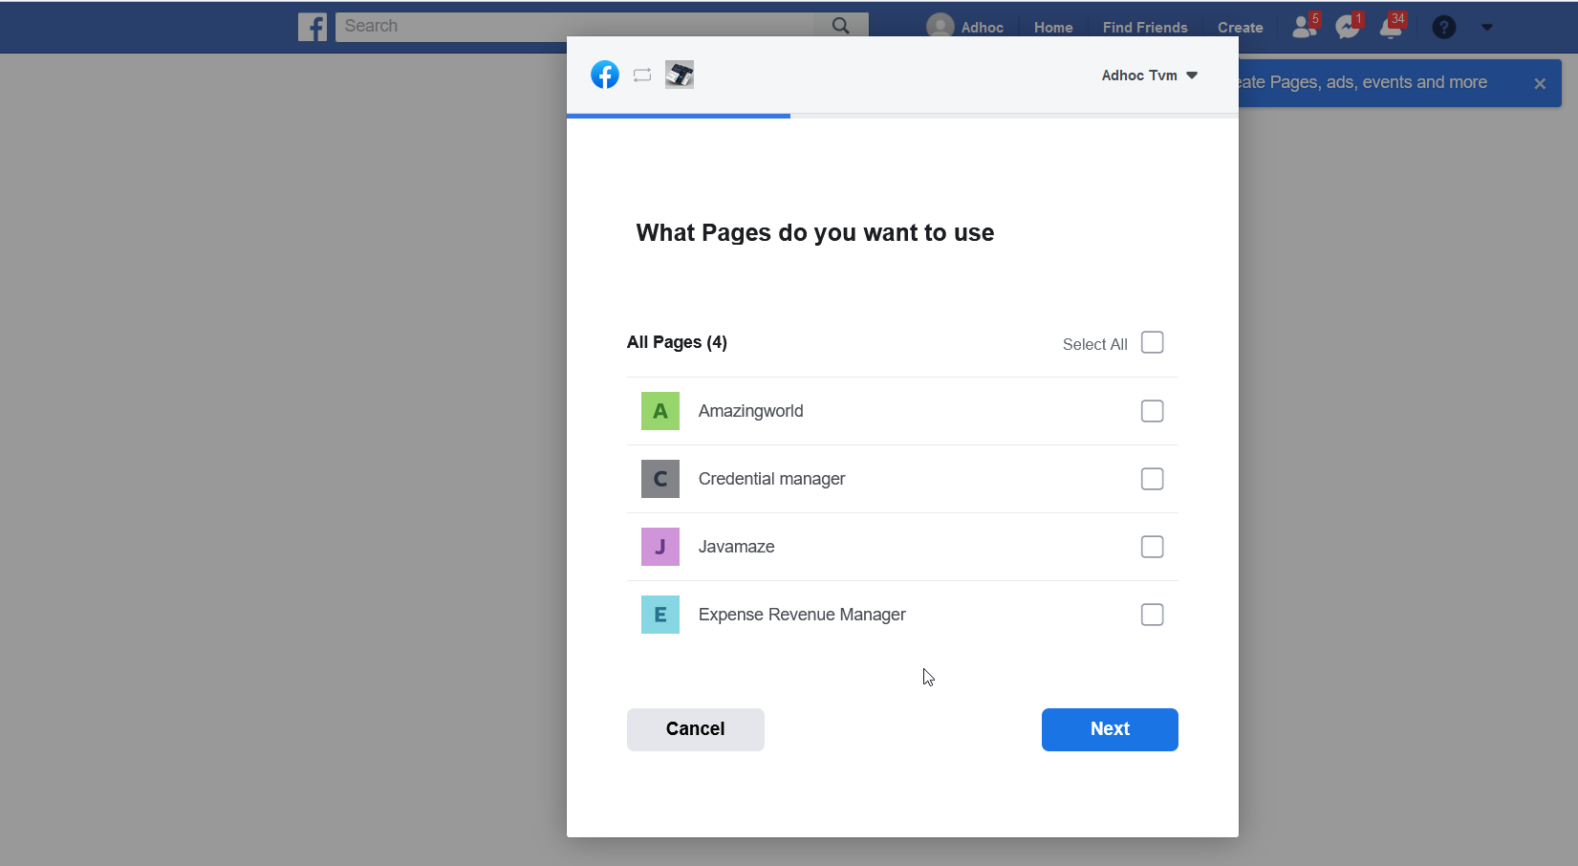

Slide 40
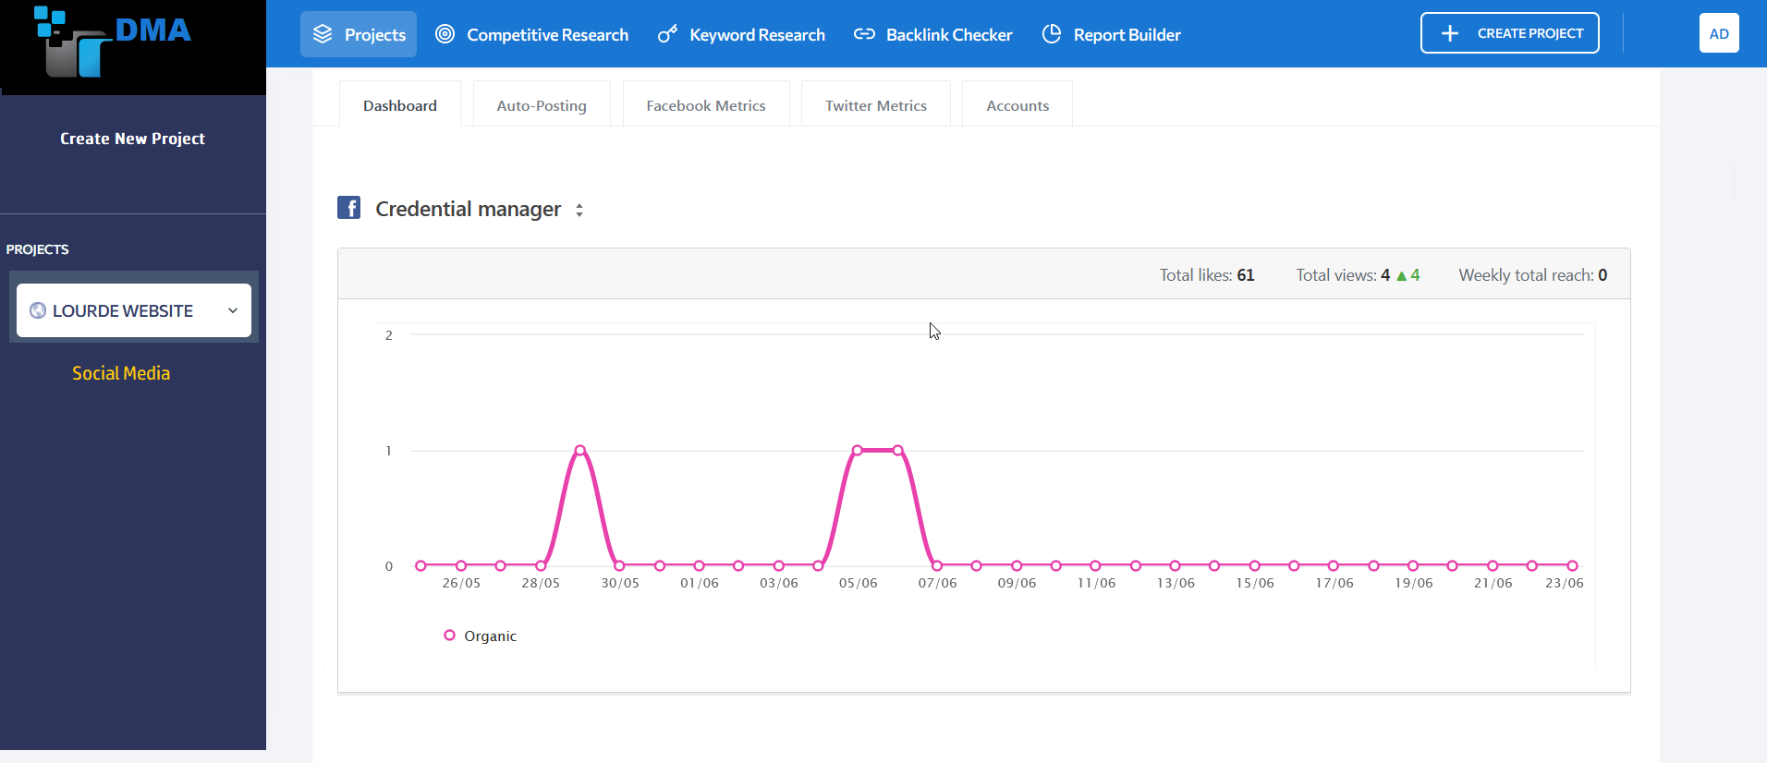

Slide 41
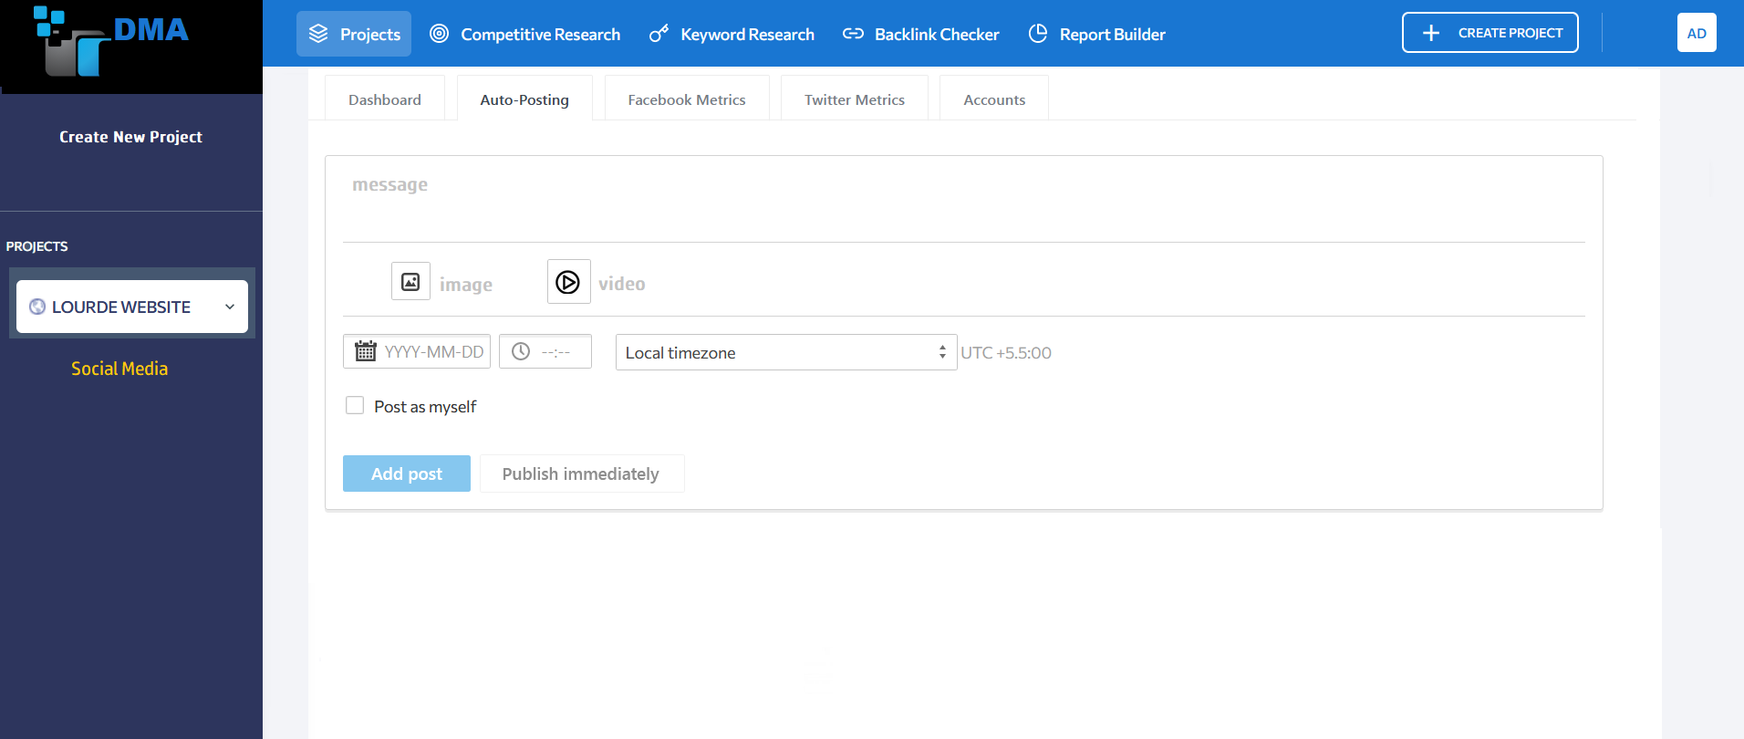

Slide 42
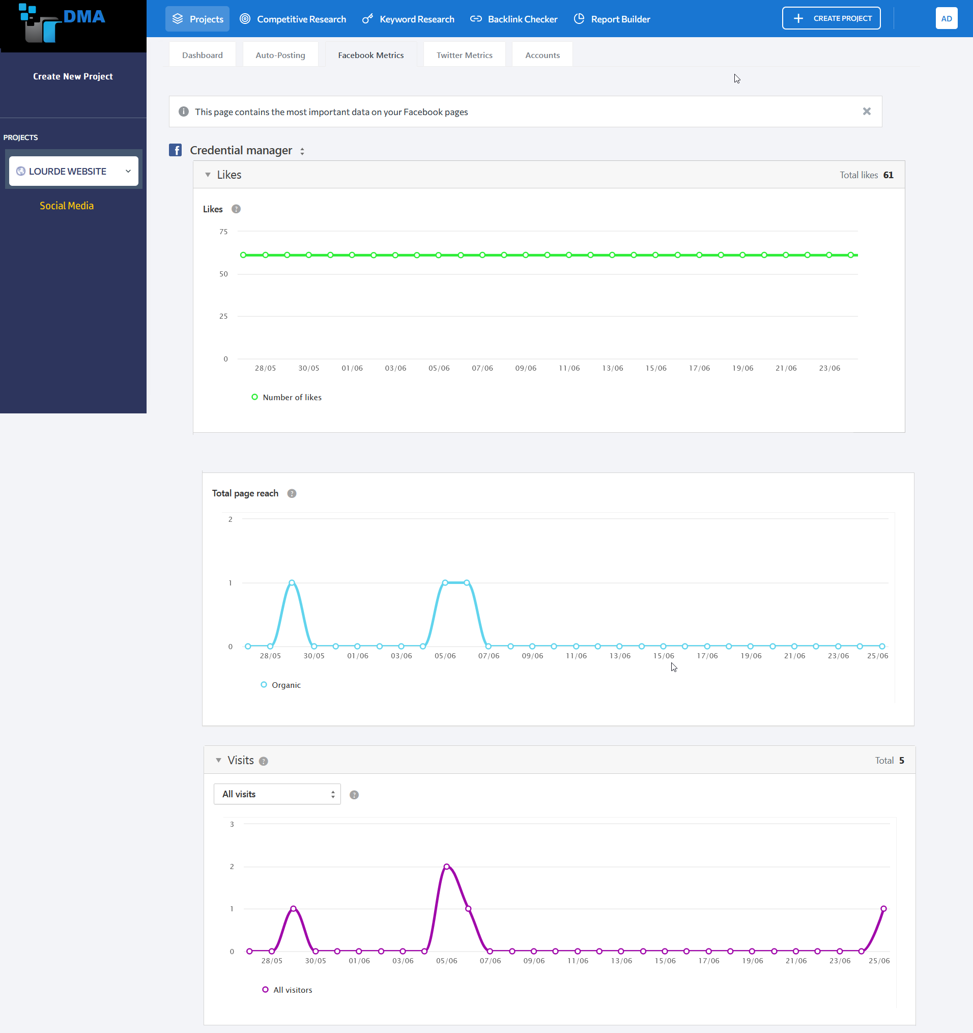

Slide 43
conclusion

Slide 44
Future enhancement
This project can be modified at any time by adding any more features and can develop the databases with more new features. The project is to satisfy the students by giving them a better virtual learning experience. This is very useful in today’s life. It should have to reach 90% above accuracy. This web provides a means of convenience, improving efficiency and accuracy for students by reducing human errors.

